Slide 1

Creating Believability
Behavior: Students will demonstrate their skills in creating believable characters on stage.
Conditions: Students will perform a countless scene dealing with environments, secrets, and physical obstacles.
Criteria: All students will participate in the activity, with at least half the class discovering how they can improve their character’s believability.

Slide 2
Which do you think would affect you the most and why?
1. Having a secret you can’t tell anyone.
2. Breaking both of your legs and being unable to walk?
3. Being trapped in a Porta Pottie?

Slide 3
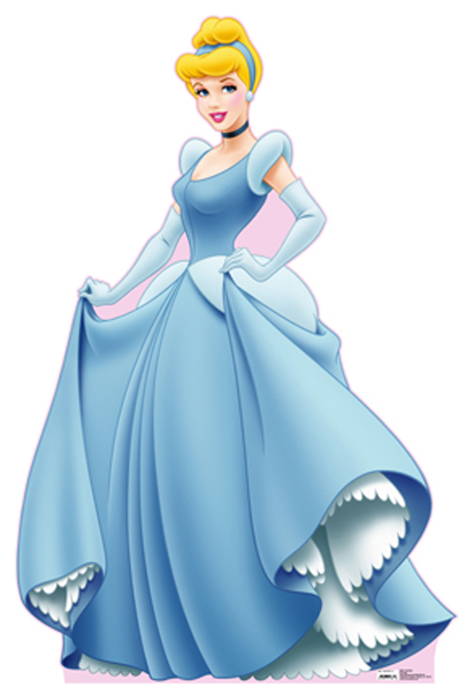
BELL WORK: Who is this chick?
Who is she?
What do you know about her?
In your teams, make a list of
everything you know about
this character. There should be
only one list per team. Pick
your top 3 most interesting facts
to share with the class.

Slide 4
DO NOW DO NOW DO NOW
Hand in your Character Breakdown homework.
Get Ready for Talk Like Shakespeare Game
Get a PENCIL out and get ready for BLOCKING notes and rehearsal.

Slide 5
Homework
Due Monday, April 27th
Memorization:
  Write everyone of your lines out two times each.
    Typed or neatly written.
    Will not except sloppy, unfinished work.

Slide 6
SAY WHAT?
DO NOW DO NOW
PICK A SENTENCE. Find three ways to say these lines in completely different ways! Use different emotion, pace, volume, etc…
Oh no! That looks like a meteor.
This puppy is the cutest little thing.
My new jacket makes me look so good.
Lebron James can’t beat me in a game of 1on1.
Have you seen the ice cream man lately?
Why can’t you just go to sleep already?
Justin Bieber is the greatest singer of all time.
I wish I could ride that large turtle.
That girl Beyonce sure can dance.
Have you ever jumped in a pool of Jello?
It looks like you have five bears chasing you.

Slide 7
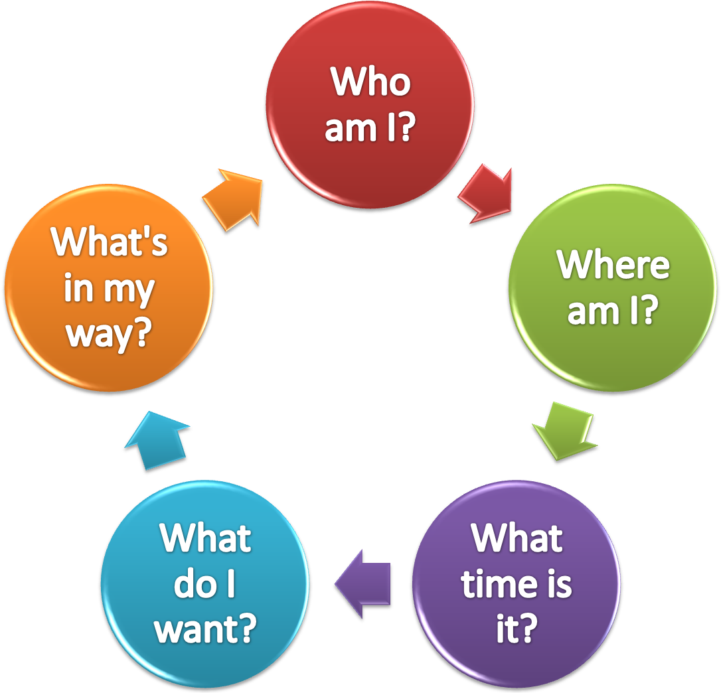
Object Exercises

Slide 8


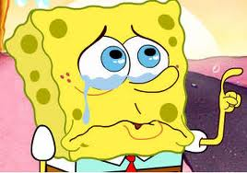
1. Who am I?
Age, Race, Religion, Height, Weight, Physical Attributes
Background
  Hobbies, Job, Likes, Dislikes

Slide 9
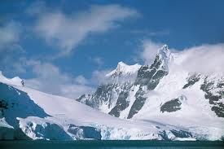

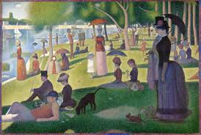
2. Where am I?
Setting in detail
Planet, Continent, Country, State, City, Town, Street, House
Time of Day
Time of Year (Season)
Past, Present, Future
  Be specific

Slide 10

3. What do I want?
What is your Goal?
What is your Objective?
The bigger the goal, the better!!!

Slide 11

4. What’s in my way?
What is keeping you from getting want you want?
Is it something or someone!?

Slide 12
5. What do I do to get what I want?

Slide 13
Task 3
Once you have performed your scene in front of the class, perform it again - but this time, the audience will be allowed toclapand ask you to freeze (a maximum of three times)
After freezing, each character in turn will tell the audience exactly what they are thinking of at that particular time. You can discuss your character’s feelings towards another character or react to what is happening on stage.
This technique is called ‘MIND TRACKING’.
Who does she think she is? Telling me what to do!
I’m beginning to lose it! He just doesn't listen to me!

Slide 14
Mind Tracking
What is Mind Tracking?
When the action of the play is frozen and the character
reveals feelings and thoughts out loud to the
audience. his/her
The other characters cannot hear him/her.
This may happen at any time within the play.

Slide 15
Task 4
The character does not know what to do!
Does he/she go to the party without the
consent of his/her parents or does he/she
stay at home?
He/she needs to consider his/her options.
Path of Conscience
Use your class members to form two lines facing each other.
2) Members of one line will attempt to persuade the character to attend the party, while members of the opposite line attempt to persuade him/her to stay at home.
The character walks between the lines and everyone will need to argue their point in turn.
4) On reaching the end of the line, the character will need to come to his/her decision.

Slide 16
Your parents will punish you for months !
PATH OF CONSCIENCE
Negative
arguments
The character walks
down the centre
and listens to the
arguments
All your friends are going !!
Positive
Arguments

Slide 17
Task 7
HOT SEAT
The Exercise
You are seated (in character) in the hot seat. The
audience will pose you some questions and you
are required to answer these questions IN CHARACTER
The Hot Seat will help you understand more
about your character
Focus
Thinking swiftly
SKILLS
Information
gained
previously
Imagination

Slide 18

Character Backgrounds
Group with a Partner.
Develop your R&J Character
Write in full sentences with DETAIL and information taken from R&J
Present character ideas to class.
Finish for homework!

Slide 19
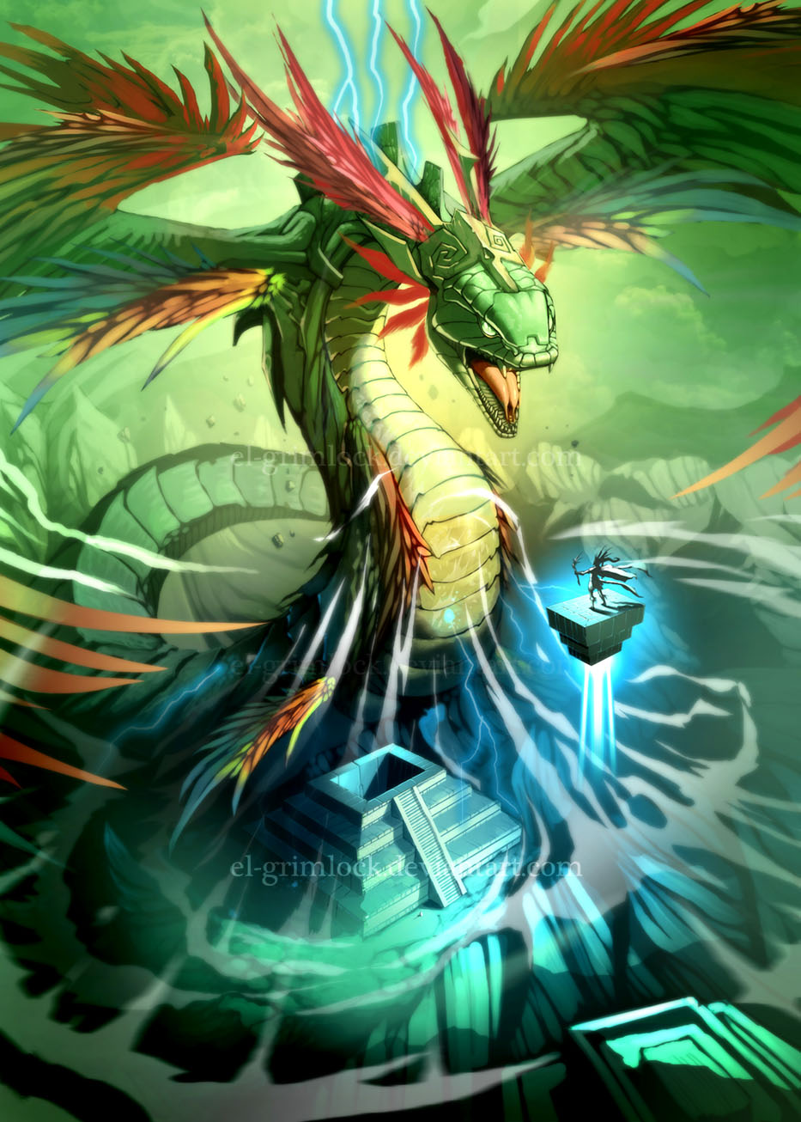
Quezacoatl Rehearsal
If NOT WORKING with Mr. Seidel…
Plot Structure Worksheet
Lines Memorization
  Write 5 times for each line
  Include lines BEFORE/AFTER just ONCE
Character Questions Sheet

Slide 20
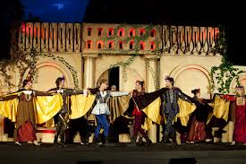
Countless Scenes
Pair up!
Pick a Countless Scene from the bucket!
Rehearse your scene.
Perform!
Class Discussion:
  What worked?
  What secrets, obstacles, environments did we see?

Slide 21
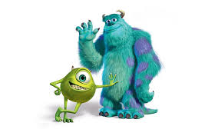
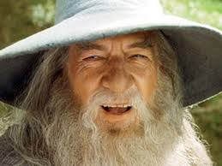
Movie Scenes
What did you see? Be specific!
  Environment?
  Secrets?
  Physical Obstacles?
What made the scene effective?
  The jokes?
  The acting?
  The tactics?
  The situation?

Slide 22

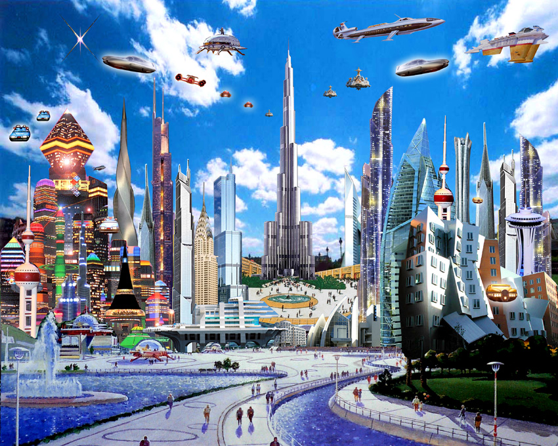
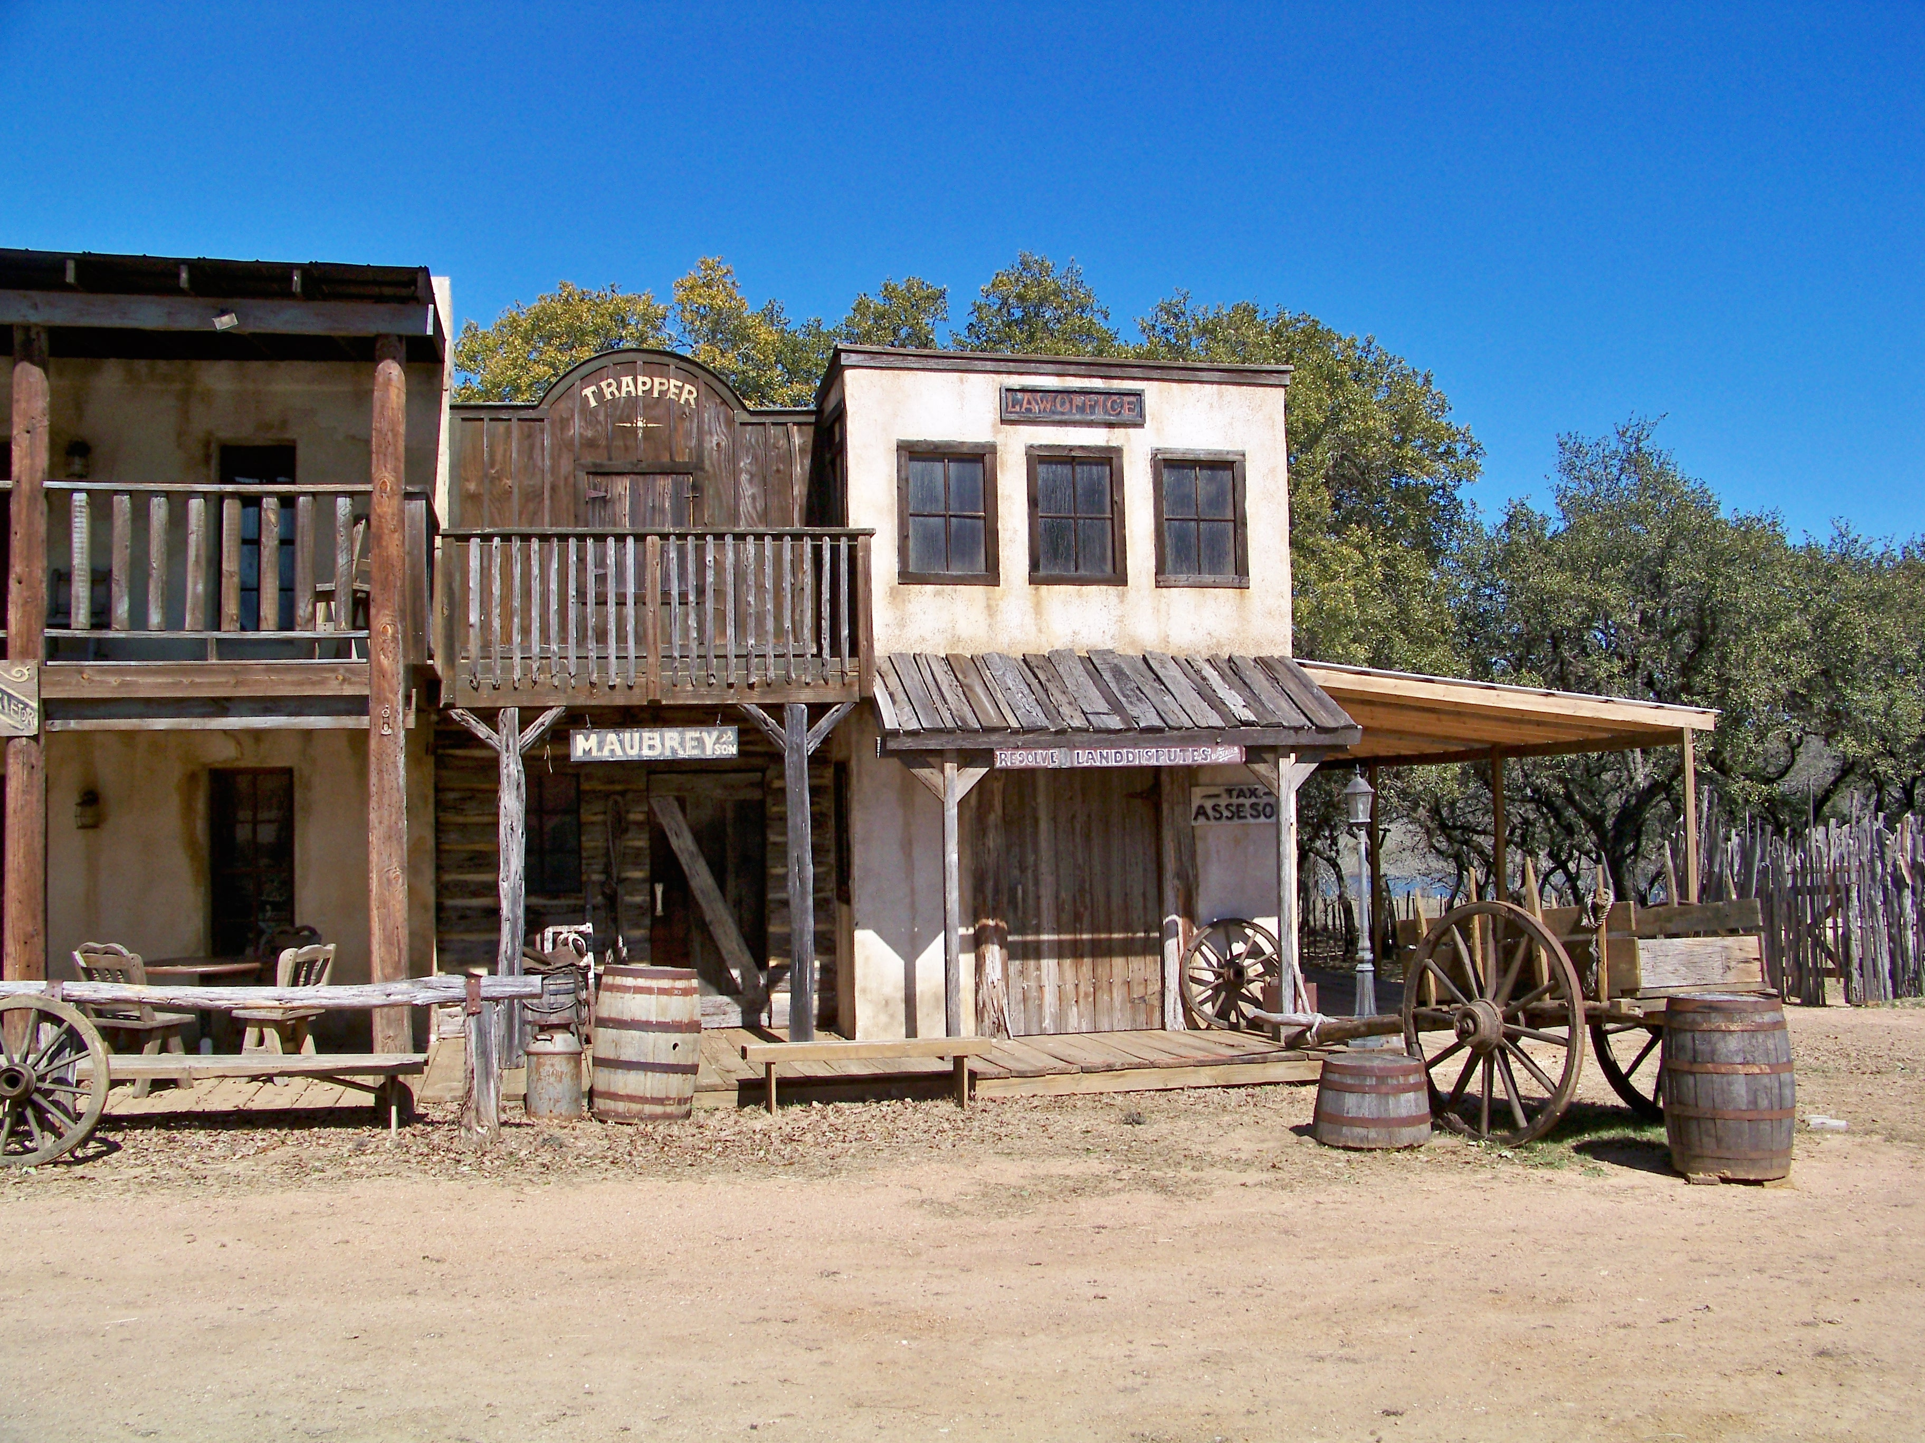
What time is it?
Time of Day
Time of Year (Season)
Past, Present, Future
  Be specific

